Slide 1

MINOR PROJECT
End-to-End Deep Learning for Self-Driving Cars
National Institute of Technology Patna
Guided by Dr. Rajarshi Bhattacharya
Suraj Kumar (1904145)
Abhay Kumar Poddar ( 1904005)
Raushan Kumar ( 1904059)

Slide 2
Objective: The purpose of this project is to simulate a self-driving car. Self Driving cars are among the trending technologies and come with various advantages which include:
Making transportation more accessible for those who cannot drive
Decreasing traffic congestion
Reducing crashes and saving lives
Providing cheaper and comparatively hassle-free transportation

Slide 3
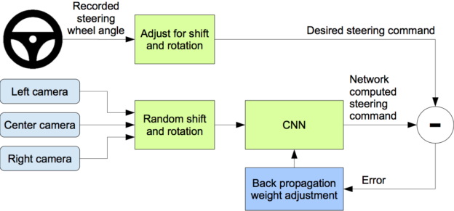
Introduction
The proposed algorithm takes three images of the road from the front side, the left side, and the right side of the vehicle and gives the optimal driving angle of the steering the car which helps the car to stay on the track and avoid going out of track and hence preventing fatal accidents.

Slide 4
Technology Used
Numpy
Pandas
Matplotlib
Python
TensorFlow
Flask
Socket.io

Slide 5
Challenges
Very Less Data
High Computational Cost And Memory Consumption
Yet To Attain Optimum Steering Performance
For now we are testing our model on one-way roads only, In two ways roads, it would be very difficult to control the steer angle and speed as we are working here only on images as to calculate distances between two objects need sensors and antennas.

Slide 6
Project Overview:
The project will contain 4 steps for its execution:
Data Collection
Data Augmentation
CNN Model
Connect our model to Udacity Simulator to check How well It performs in real environments
Data Collection:
For data collection, we will use the Udacity simulator. In the simulator, at the car head, three cameras( left, center, and right) are used for capturing the environmental view.

Slide 7
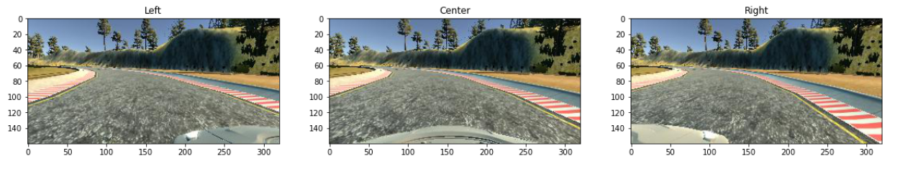
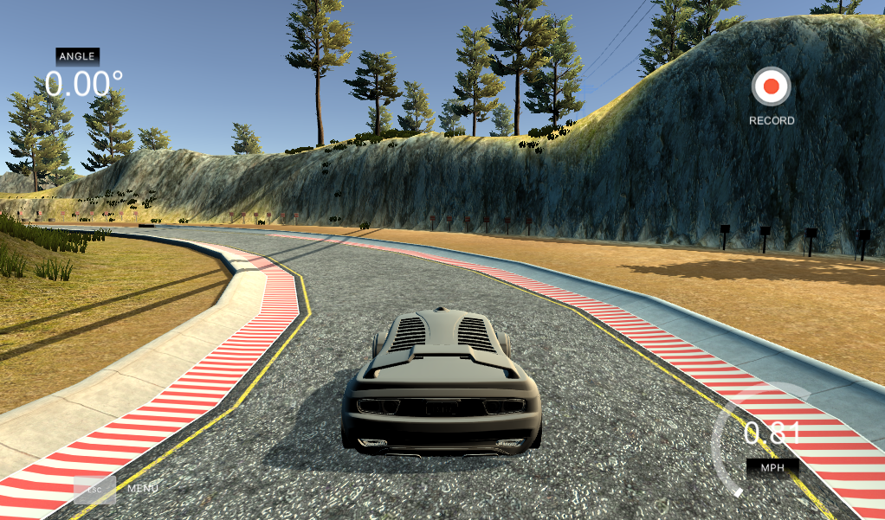
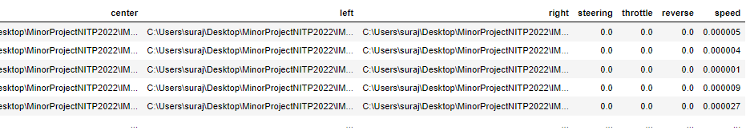
Data Collection Interface:

Slide 8
Data Augmentation
We used multiple data augmentation techniques to increase the size of the dataset as it was too limited for training a deep learning model.
To generate augmented samples, we used
Random Shadowing
Fliping
Random Translation
Changing the Brightness
Image Rotationing
Gaussian noise

Slide 9

Proposed Model:
In the ML Model, we used a CNN(Convolution Neural Network) as we are working on Images.
Generally,
CNN = Feature extraction + Classification

Slide 10
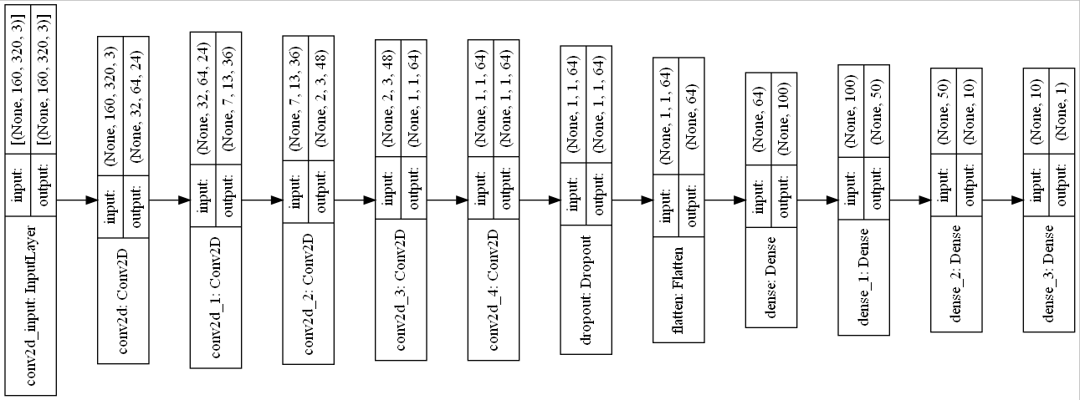
Architecture of Model 1:

Slide 11
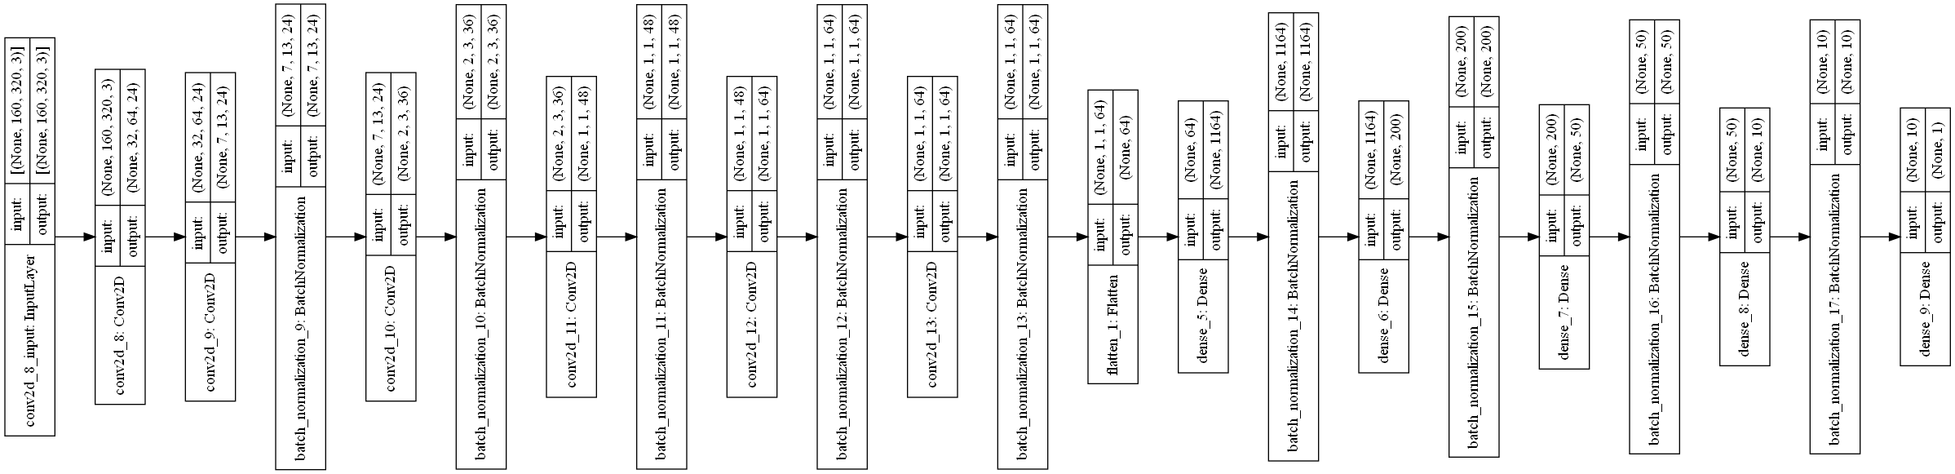
Architecture of Model 2:-

Slide 12
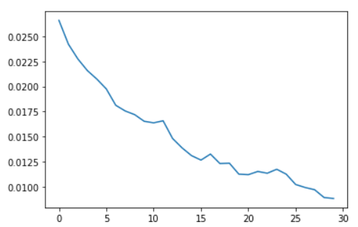
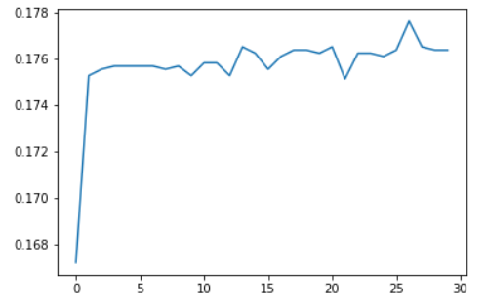
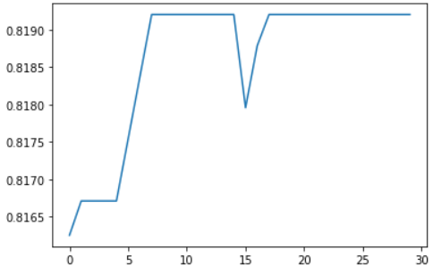
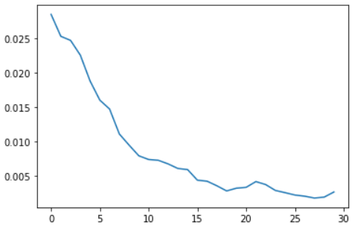
Results
Accuracy
Loss
Model 1
Model 2

Slide 13
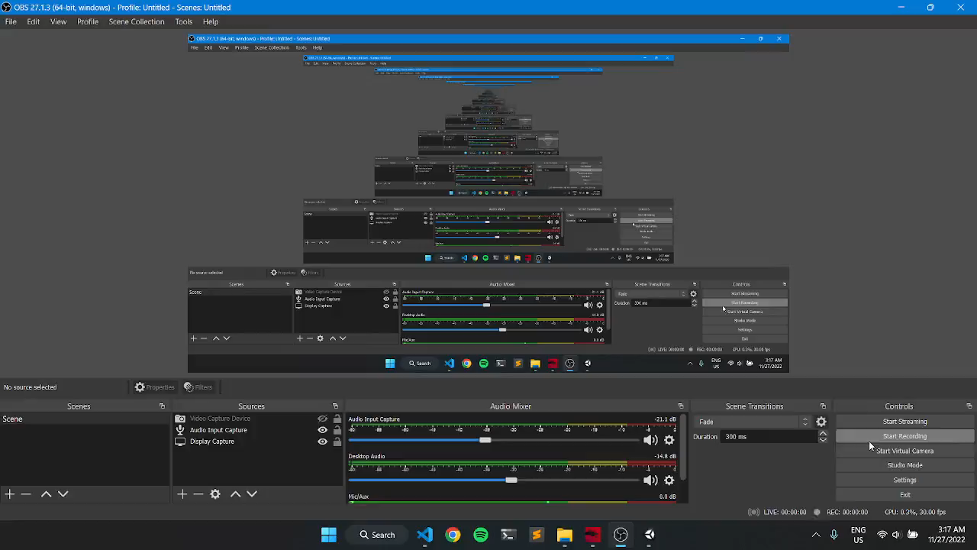
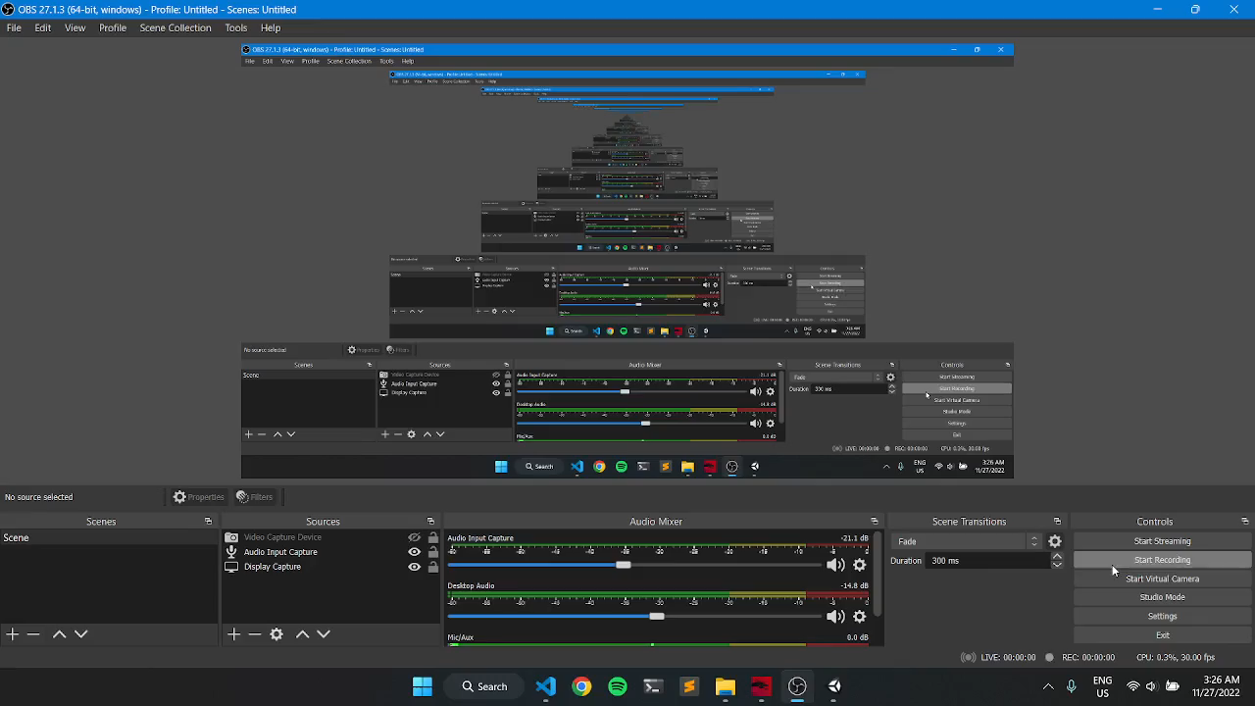
Results Cont..
Auto Car Driving on Track 1
Auto Car Driving on Track 2

Slide 14
CONCLUSION
This project started with training the model and tweaking parameters to get the best performance on the tracks and then trying to generalize the same performance on different tracks.
We trained the CNN model using Adam as the optimizer. After much, tweaking of parameters, and experimentation of multiple models, we ended up with one model that is able to drive the car autonomously.
We have demonstrated that CNNs are able to learn the entire task of lane and road following without manual decomposition into road or lane marking detection.

Slide 15
Links and References
GitHub link: https://github.com/kumarSuraj-bit/Minor-Project-NITP
Nvidia Paper for self-car driving: https://developer.nvidia.com/blog/deep-learning-self-driving-cars/
Gidado, U.M., Chiroma, H., Aljojo, N., Abubakar, S., Popoola, S.I. and Al-Garadi, M.A., 2020. A survey on deep learning for steering angle prediction in autonomous vehicles. IEEE Access, 8, pp.163797-163817.
Udacity Simulator: https://github.com/udacity/self-driving-car-sim

Slide 16


